Slide 1

Chapter 5.4
Delay System GI/M/1
Performance Evaluation of the Internet of Things (IoT)
Module Course: Performance Evaluation of Distributed Systems
Prof. Tobias Hoßfeld, Summer Semester 2022

Slide 2
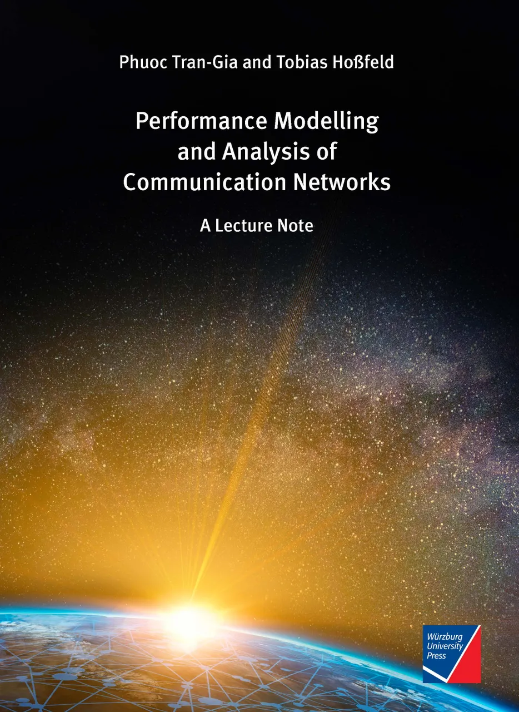
Disclaimer and Copyright Notice
Lecture slides, figures, and scripts are based on the open access text book “Performance Modeling and Analysis of Communication Networks”. The book and scripts are licensed under the Creative Commons License Attribution-ShareAlike 4.0 International (CC BY-SA 4.0). If you remix, transform, or build upon the material, you must distribute your contributions under the same license as the original.
The book must be cited and the disclaimer attached when using lectures slides or scripts.
Tran-Gia, P. & Hossfeld, T. (2021). Performance Modeling and Analysis of Communication Networks - A Lecture Note. Würzburg University Press. https://doi.org/10.25972/WUP-978-3-95826-153-2
Website to download book, exercises, slides and scripts: https://modeling.systems/

Slide 3
Chapter 5
5 Analysis of Non-Markovian Systems
5.1 Discrete-Time Markov Chain
5.2 Method of Embedded Markov Chain
5.2.1 Power Method for Numerical Derivation
5.2.2 Notion of Embedding Times
5.2.3 Kleinrock’s Result
5.3 Delay System M/GI/1
5.3.1 Model Structure and Parameters
5.3.2 Markov Chain and State Transition
5.3.3 State Equation
5.3.4 State Probabilities
5.3.5 Delay Distribution
5.3.6 Other System Characteristics
5.3.7 State Probabilities at Arbitrary Time
5.4 Delay System GI/M/1
5.4.1 Model Structure and Parameters
5.4.2 Markov Chain and State Transition
5.4.3 State Probabilities
5.4.4 State Analysis with Geometric Approach
5.4.5 Waiting Time Distribution
5.5 Model with Batch Service and Threshold Control
5.5.1 Model Structure and Parameters
5.5.2 Markov Chain and State Transition
5.5.3 State Probabilities and System Characteristics
5.6 Results for Continuous-Time GI/GI/1 Delay Systems
5.6.1 Characteristics of GI/GI/1 Delay Systems
5.6.2 Lindley Integral Eq. GI/GI/1 Systems
5.6.3 Kingman’s Approximation of Mean Waiting Times

Slide 4
Model Structure and Parameters

Slide 5
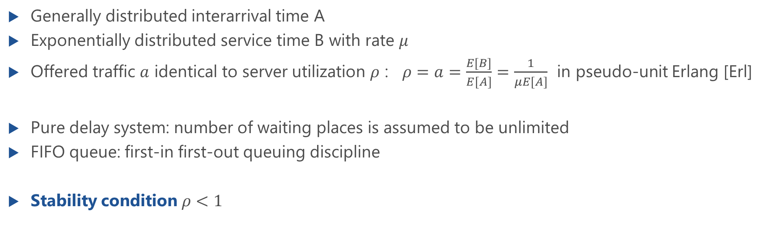
Delay System GI/M/1
Generally distributed interarrival time A
Exponentially distributed service time B with rate $μ$
Offered traffic $a$ identical to server utilization $ρ$ : $ρ=a=\frac{E[B]}{E[A]}=\frac{1}{μE[A]}$ in pseudo-unit Erlang [Erl]
Pure delay system: number of waiting places is assumed to be unlimited
FIFO queue: first-in first-out queuing discipline
Stability condition $ρ<1$

Slide 6
State Process of GI/M/1 Delay System
number of customers at time t
Markov chain: $\{X\left(t_{0}\right),X\left(t_{1}\right),…,X\left(t_{n}\right),X\left(t_{n+1}\right), …\}$

Slide 7
Markov Chain and State Transition

Slide 8
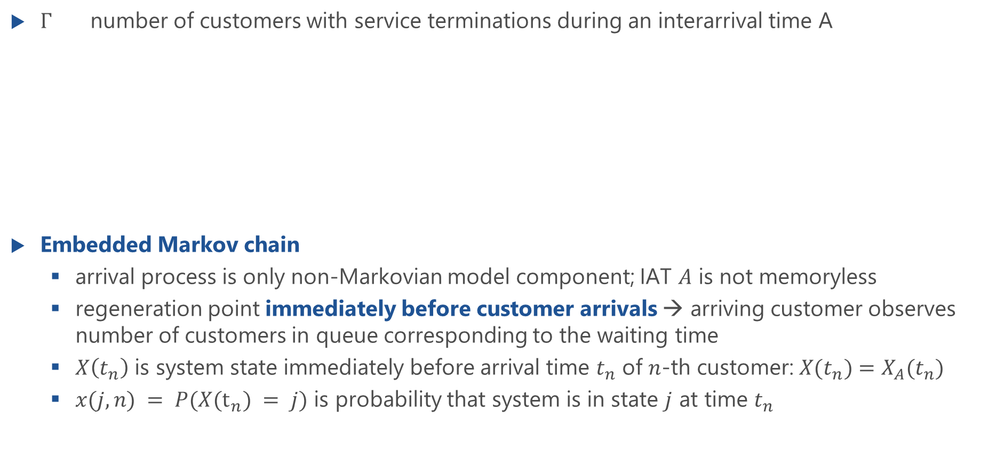
Embedded Markov Chain
$Γ$ number of customers with service terminations during an interarrival time A
Embedded Markov chain
arrival process is only non-Markovian model component; IAT $A$ is not memoryless
regeneration point immediately before customer arrivals → arriving customer observes number of customers in queue corresponding to the waiting time
$X\left(t_{n}\right)$ is system state immediately before arrival time $t_{n}$ of $n$-th customer: $X(t_{n})=X_{A}(t_{n})$
$x(j,n) = P(X(t_{n}) = j)$ is probability that system is in state $j$ at time $t_{n}$

Slide 9
Transition Probability
Transition probability between two successive regeneration points (embedding immediately before arrivals)
Case 1:
j ≠ 0:
Case 2:
j = 0:
(i+1-j) service ends during an interarrival time
at least (i+1) service ends
during an interarrival time
i
j
i
j=0
t
n
t
n+1
t
n
t
n+1

Slide 10
State Transition Probability and State Transition Matrix
Two types of transitions are distinguished
j≠0
j=0
State transition matrix of the GI/M/1 delay system

Slide 11
State Probabilities

Slide 12
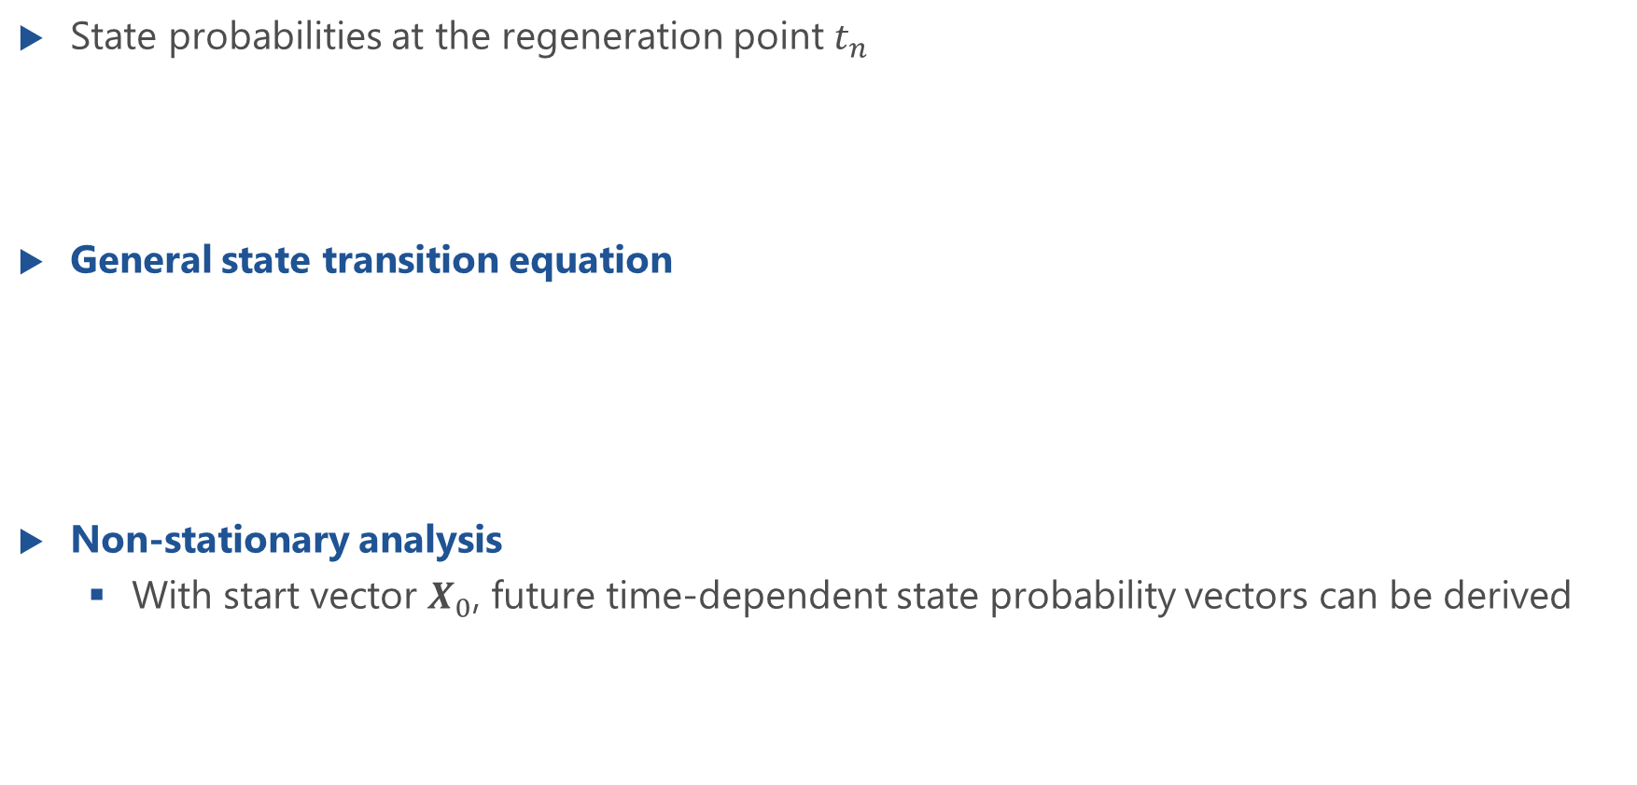
General State Transition Equation
State probabilities at the regeneration point $t_{n}$
General state transition equation
Non-stationary analysis
With start vector $X_{0}$, future time-dependent state probability vectors can be derived

Slide 13
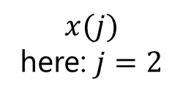
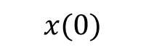
Stationary Analysis GI/M/1
In statistical equilibrium
Stationary state transition equation
left eigenvector of transition probability matrix to eigenvalue 1
Components of state probability vector
$$x(0)$$
$$x(j)$$
here: $j=2$

Slide 14
State Analysis with Geometric Approach

Slide 15
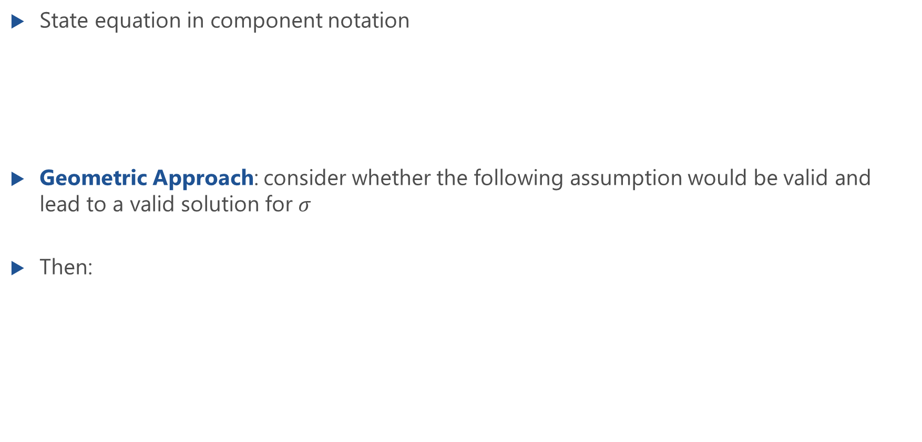
State Analysis with Geometric Approach
State equation in component notation
Geometric Approach: consider whether the following assumption would be valid and lead to a valid solution for $σ$
Then:

Slide 16
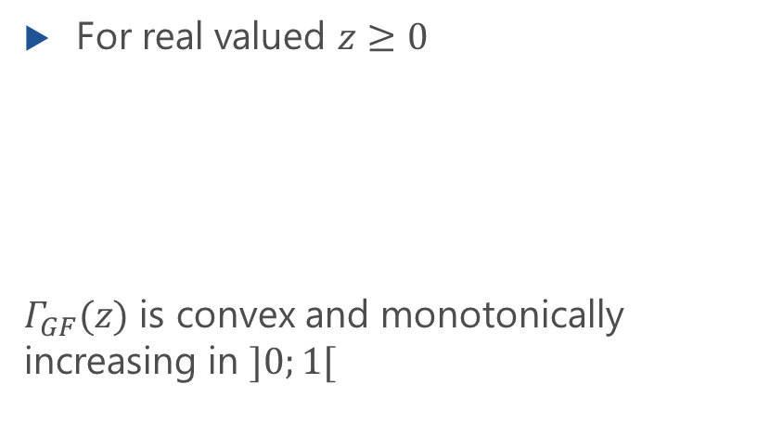
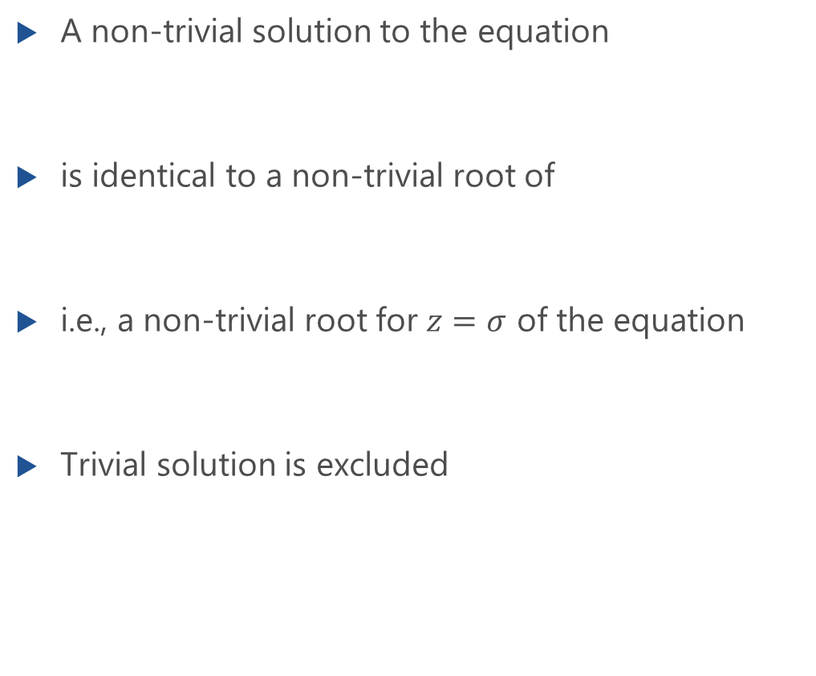
State Analysis with Geometric Approach: Non-Trivial Root
A non-trivial solution to the equation
is identical to a non-trivial root of
i.e., a non-trivial root for $z=σ$ of the equation
Trivial solution is excluded
For real valued $z≥0$
$Γ_{GF}(z)$ is convex and monotonically increasing in $]0;1[$

Slide 17
Visualization: Non-Trivial Root
non-trivial solution
only trivial solution

Slide 18
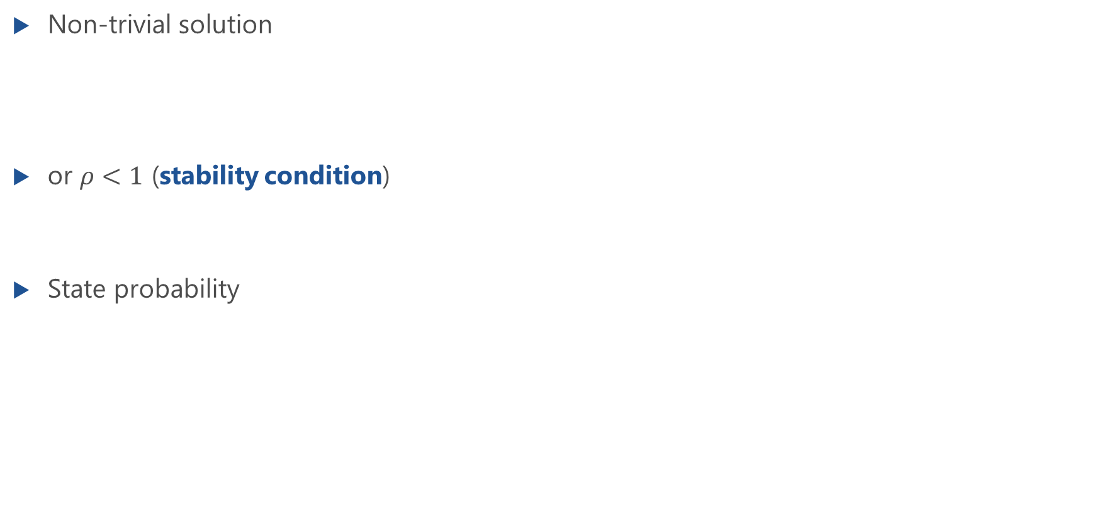
Summary: Analysis with Geometric Approach
Non-trivial solution
or $ρ<1$ (stability condition)
State probability

Slide 19
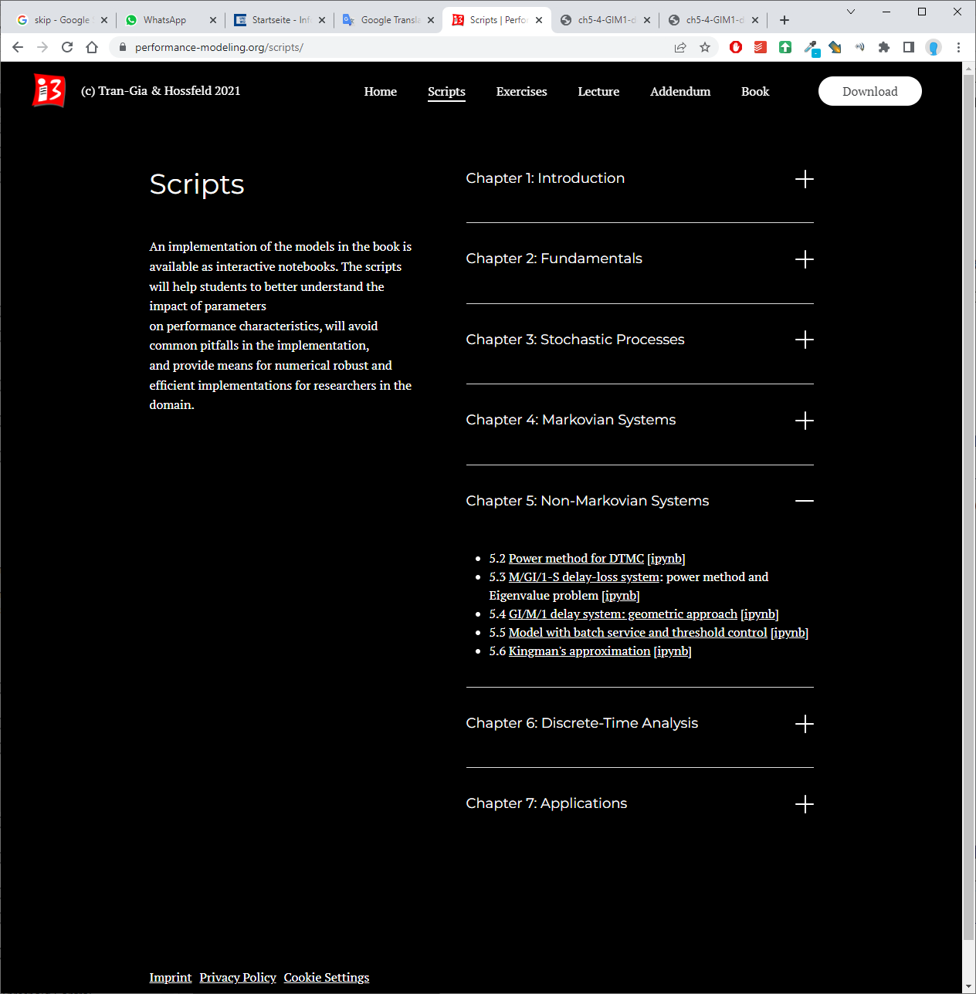
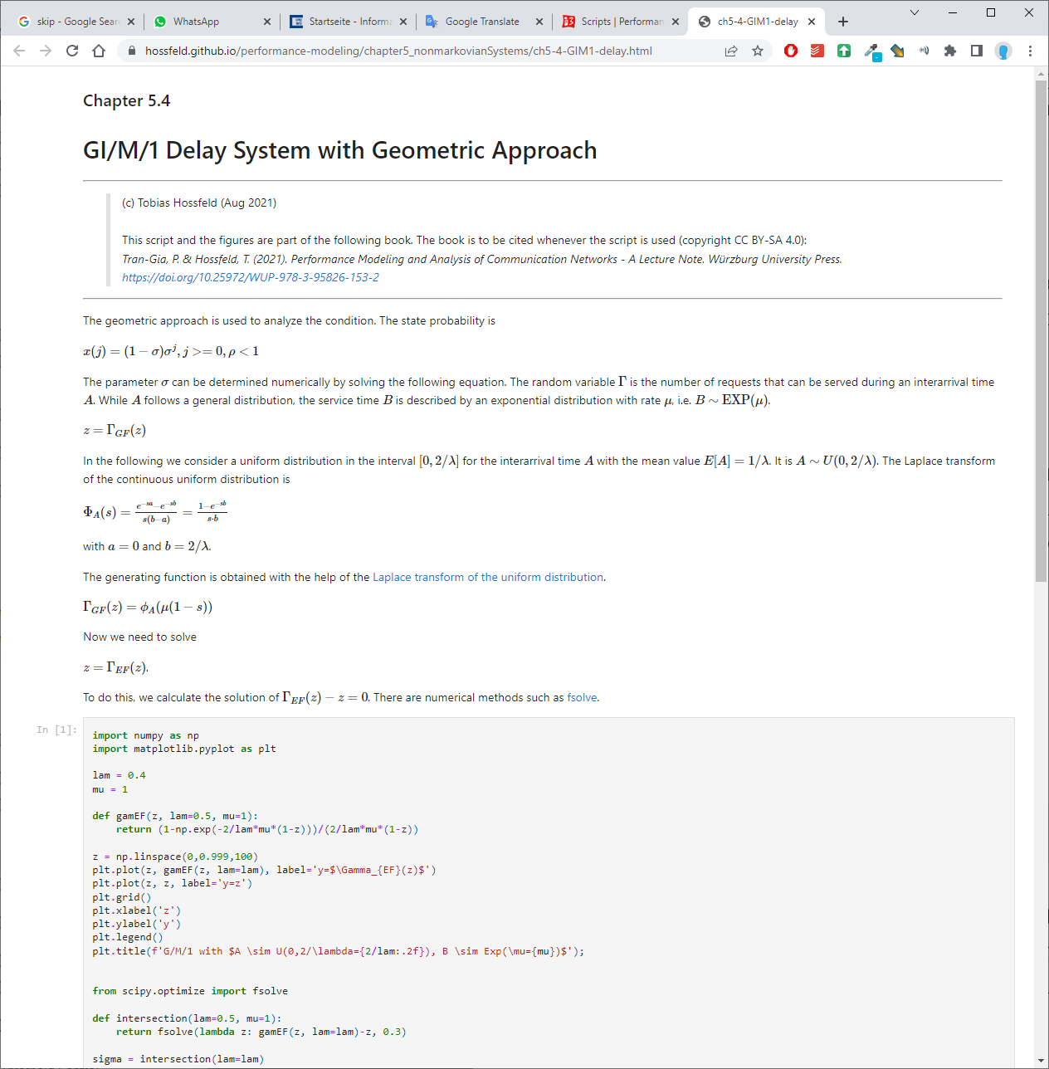
https://modeling.systems/

Slide 20
Waiting Time Distribution

Slide 21
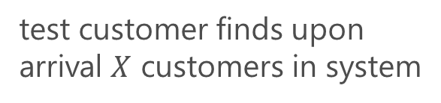
Waiting Time Distribution
Derivation in the same way as the waiting time analysis of the M/M/n delay system
test customer
x
x
x
x
x
test customer finds upon arrival $X$ customers in system

Slide 22
Waiting Time Distribution (f.)
Waiting time of GI/M/1 delay system for all customers

Slide 23
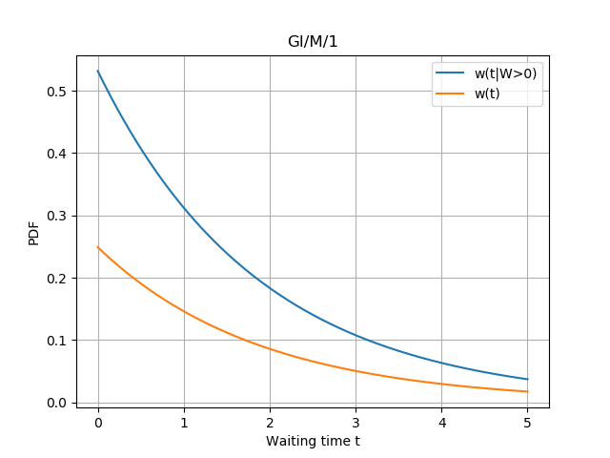
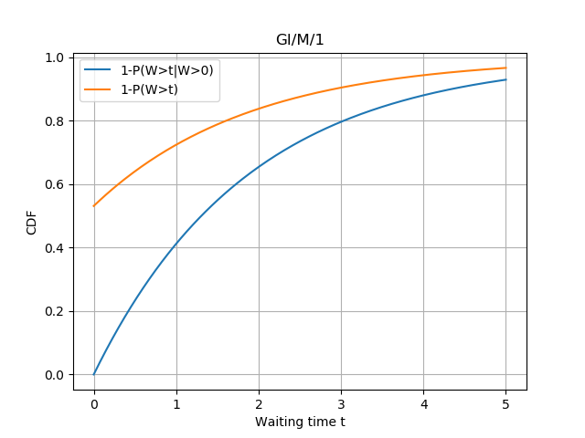
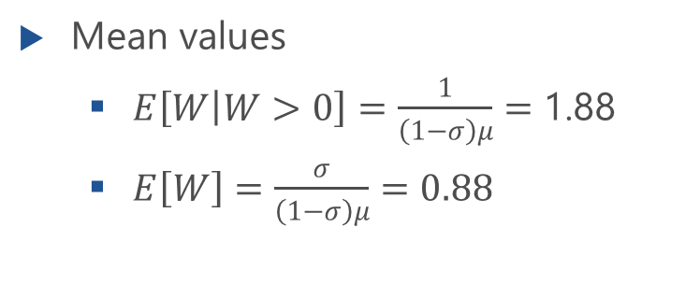
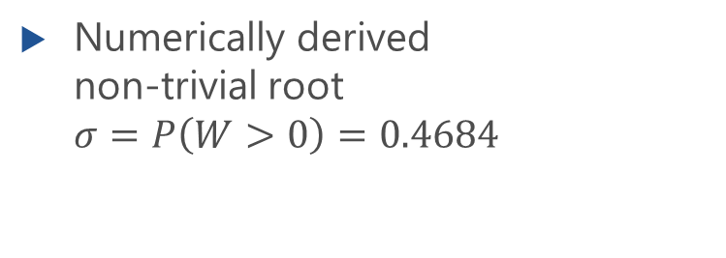
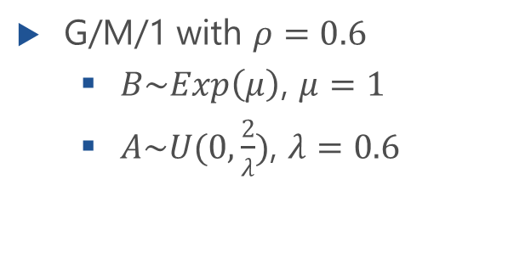
Example 1: Uniform Interarrival Times
G/M/1 with $ρ=0.6$
$B\sim Exp\left(μ\right)$, $μ=1$
$A\sim U(0,\frac{2}{λ})$, $λ=0.6$
Numerically derived non-trivial root $σ=P\left(W>0\right)=0.4684$
Mean values
$E\left[W | W>0\right]=\frac{1}{\left(1−σ\right)μ}=$ 1.88
$E\left[W\right]=\frac{σ}{\left(1−σ\right)μ}=0.88$

Slide 24
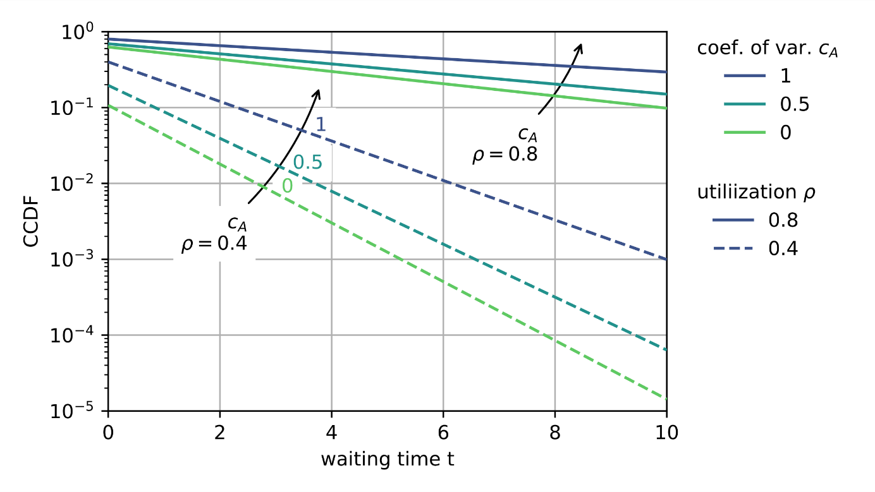
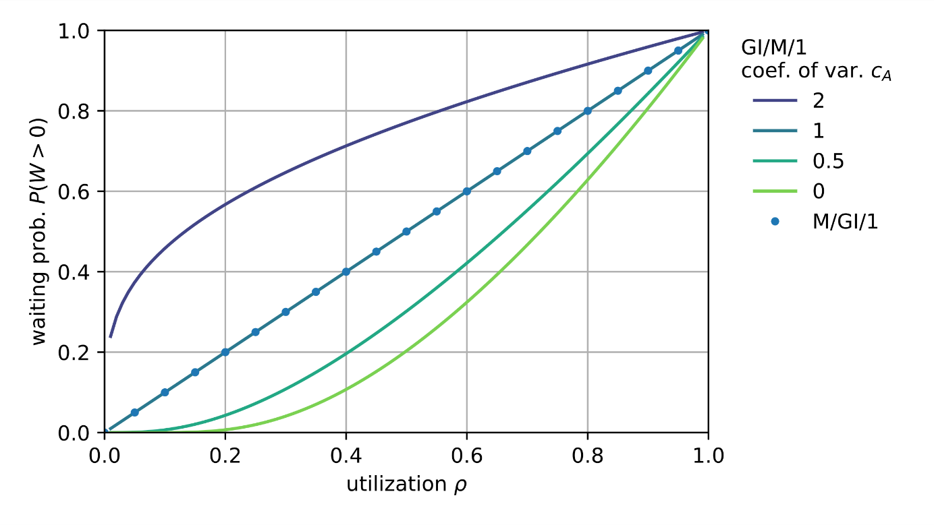
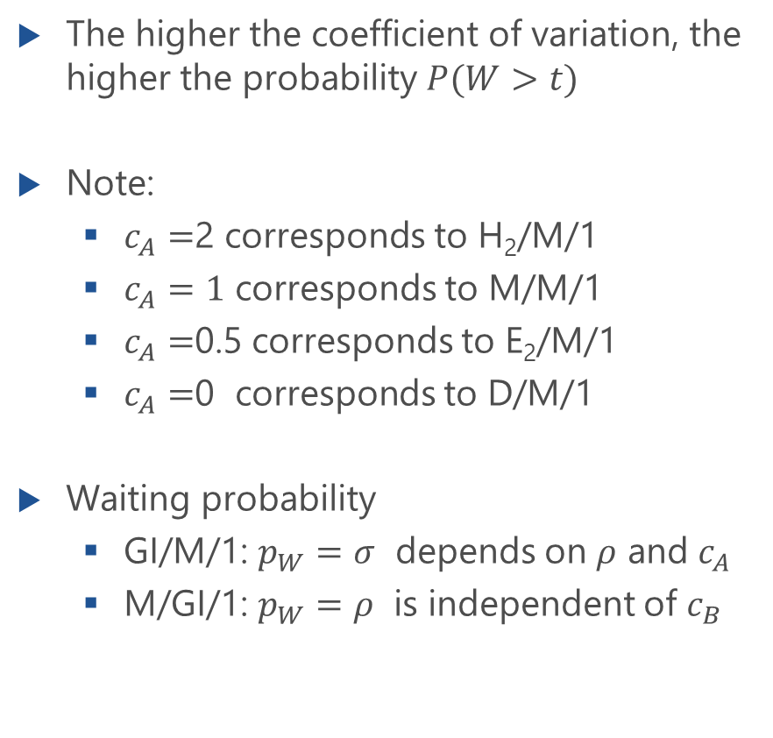
Example 2: Parameter Study
The higher the coefficient of variation, the higher the probability $P(W>t)$
Note:
$c_{A}=$2 corresponds to H₂/M/1
$c_{A}=1$ corresponds to M/M/1
$c_{A}=$0.5 corresponds to E₂/M/1
$c_{A}=$0 corresponds to D/M/1
Waiting probability
GI/M/1: $p_{W}=σ$ depends on $ρ$ and $c_{A}$
M/GI/1: $p_{W}=ρ$ is independent of $c_{B}$

